Slide 1
Mountainboard - Lesson 7
Sweeps and Lofts – Springs and Binding
School’s Name
Teacher’s Name
Date

Slide 2
Loft Feature Overview
Blends multiple profiles together.
A Loft feature can be a base, boss, or cut.
To Create a Simple Loft Feature:
Create the planes required for the profile sketches.
Each sketch should be on a different plane.

Slide 3
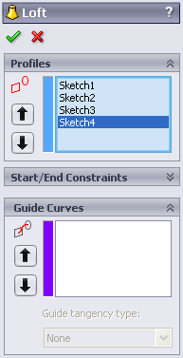
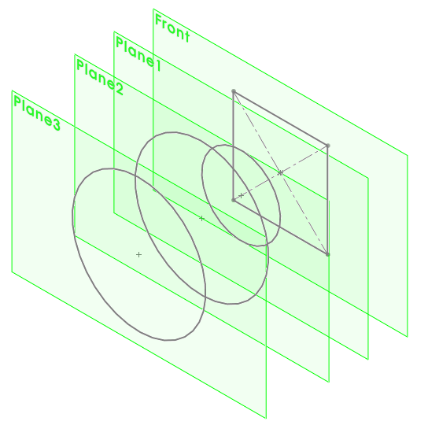
Creating a Simple Loft Feature:
Sketch a profile on the first plane.
Sketch the remaining profiles on their corresponding planes.
Click Loft on the Features toolbar.

Slide 4
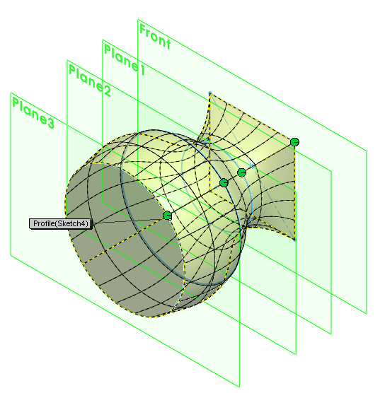
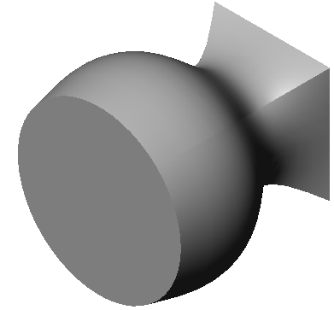
Creating a Simple Loft Feature:
Select each profile.
Examine the preview curve and the connectors.
Click OK.
Preview curve
Connectors

Slide 5
Additional Information About Lofts:
Neatness counts!
  Select the profiles in order.
  Click corresponding points on each profile.
  The vertex closest to the selection point is used.
  Drag the connectors to improve if necessary.
A preview curve connecting
the profiles is displayed.
Review the curve in order to
address adjustments.

Slide 6
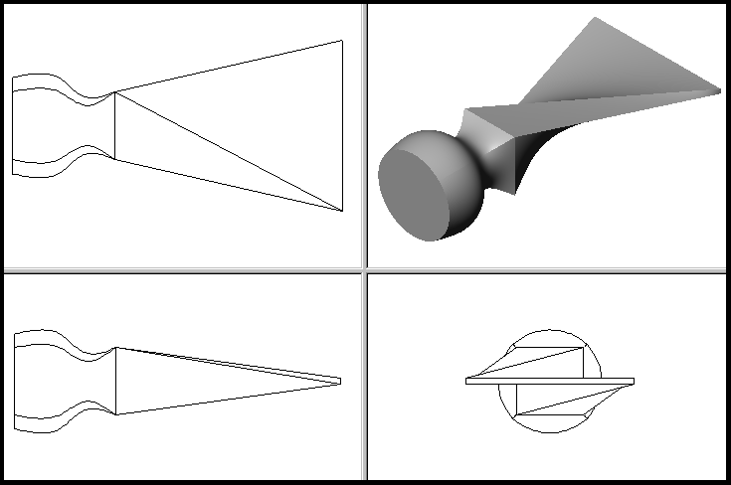
Neatness Counts!
Unexpected results occur when you don’t pick corresponding points on each profile.

Slide 7
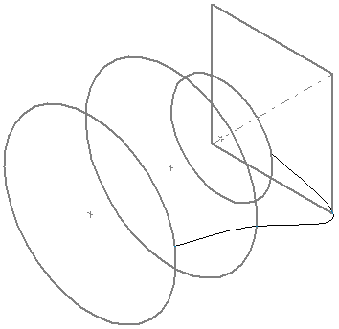

Neatness Counts!
Rebuild errors can occur if you select the profiles in the wrong order.

Slide 8
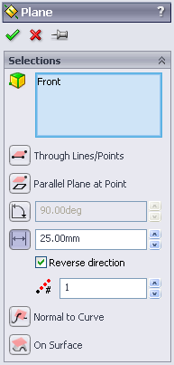
To Create an Offset Plane:
Hold down Ctrl and drag the Front plane in the direction you want the offset to go.
NOTE: Ctrl-drag is a common Windows technique for copying objects.
The Plane PropertyManager appears.
Enter 25mm for Distance.
Click OK .

Slide 9
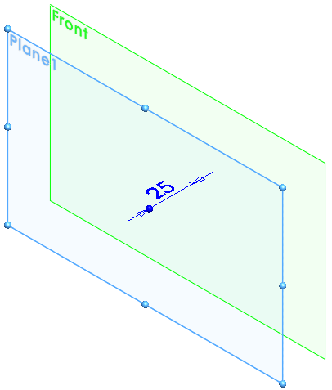
Creating an Offset Plane – Results

Slide 10
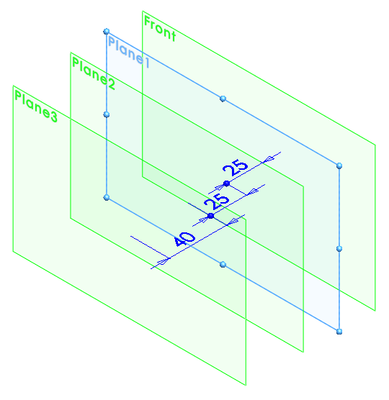
Setting up the Planes
Additional offset planes are required.
Plane2 is offset 25mm from Plane1.
Plane3 is offset 40mm from Plane2.
Verify the positions of the planes.
  Click View, Planes.
  Double-click the planes to see their offset dimensions.

Slide 11
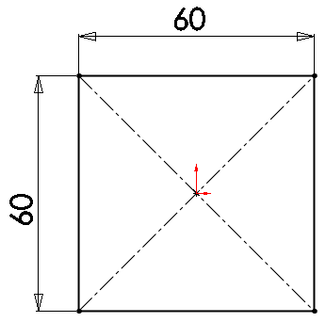
Sketch the Profiles
The Loft feature is created with 4 profiles.
Each profile is on a separate plane.
To Create the First Profile:
Open a sketch on the Front plane.
Sketch a square.
Exit the sketch.

Slide 12
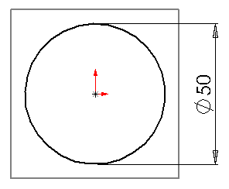
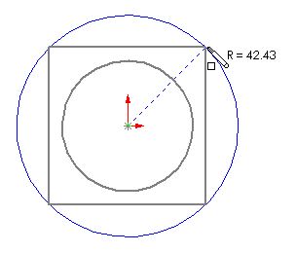
Sketch the Remaining Profiles:
Open a sketch on Plane1.
Sketch a circle and dimension it.
Exit the sketch.
Open sketch on Plane2.
Sketch a circle whose circumference is coincident with the corners of the square.
Exit the sketch.

Slide 13
To Copy a Sketch:
Select Sketch3 in the FeatureManager design tree or graphics area.
Click Edit, Copy or click
Copy on the Standard
toolbar.
Select Plane3 in the
FeatureManager design tree
or graphics area.
Click Edit, Paste or click Paste on the Standard toolbar .
A new sketch, Sketch4, is created on Plane3.

Slide 14
More About Copying Sketches
External relations are deleted.
For example, when you copied Sketch3, the geometric relations locating the center and defining the circumference were deleted.
Therefore, Sketch4 is underdefined.
To fully define Sketch4, add a Coradial relation between the copied circle and the original.
If you sketch a profile on the wrong plane, move it to the correct plane using Edit Sketch Plane. Do not copy it.

Slide 15

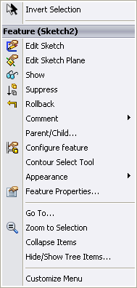
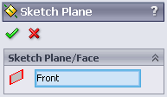
To Move a Sketch to a Different Plane:
Right-click the sketch in the FeatureManager design tree.
Select Edit Sketch Plane from either the Context toolbar or the shortcut menu.
Select a different plane.
Click OK .

Slide 16
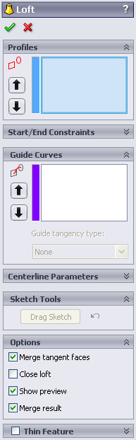
Loft Feature
The Loft feature blends the 4 profiles to create the handle of the chisel.
Click Loft on the Features toolbar.

Slide 17
Creating the Loft Feature:
Select each profile.
Click on each sketch in the same relative location – the right side.
Examine the preview curve.
The preview curve shows how the profiles will be connected when the loft feature is created.
Preview curve

Slide 18
Creating the Loft Feature:
The sketches are listed in the Profiles box.
The Up/Down arrows are used to rearrange the order of the profiles.

Slide 19
Creating the Loft Feature:
Click OK .

Slide 20
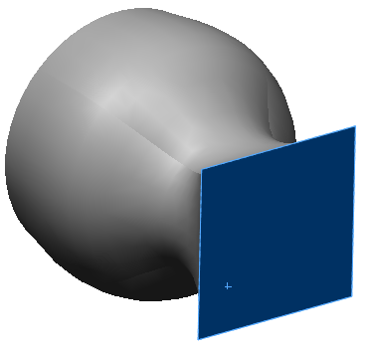
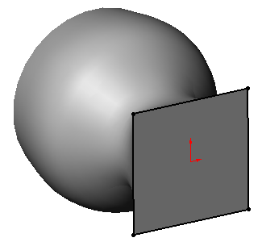
A Second Loft Feature Creates the Bit of the Chisel:
The second Loft feature is composed of two profiles: Sketch5 and Sketch6.
To Create Sketch5:
Select the square face.
Open a sketch.
Click Convert Entities .
Exit the sketch.

Slide 21
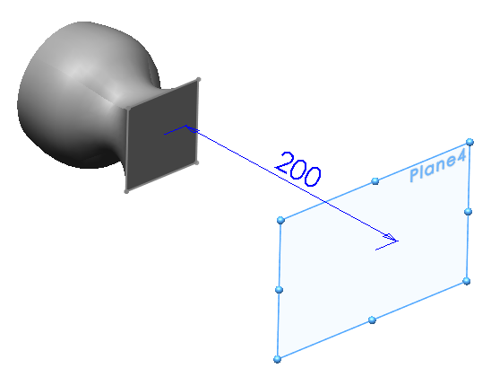
To Create Sketch6:
Offset Plane4 behind the
Front plane.
Hold down Ctrl and drag
the Front plane in the
direction you want the
offset to go.
The Plane PropertyManager appears.
Enter 200mm for Distance.
Click OK .

Slide 22
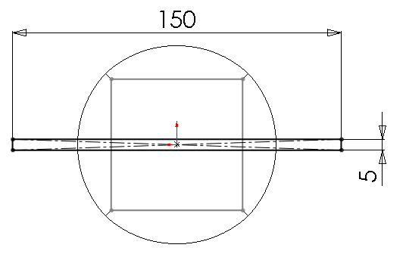
To Create Sketch6:
Open a sketch on Plane4.
Sketch a narrow rectangle centered on the origin.
Dimension the rectangle.
Exit the sketch.

Slide 23
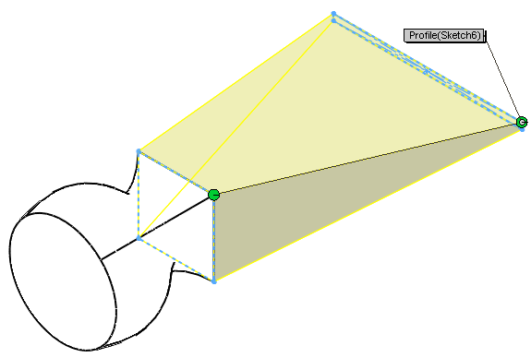
To Create the Second Loft Feature:
Click Loft on the Features toolbar.
Select Sketch5 in the
upper right corner of
the square.
Select Sketch6 in the
upper right corner of
the rectangle.
Examine the preview
curve.
Click OK.
Sketch 6
Preview
Sketch 5

Slide 24
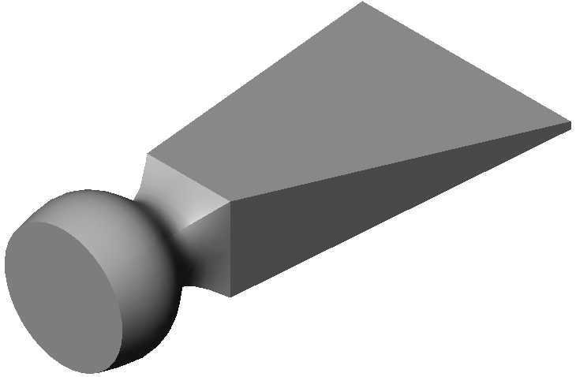
Finished Chisel

Slide 25
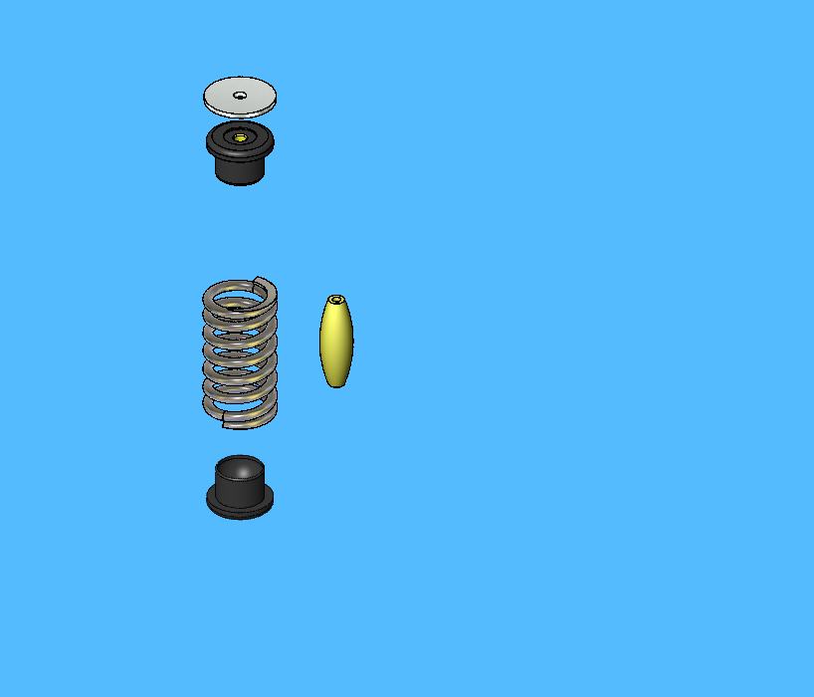
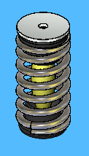
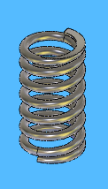
Spring Assembly
Several parts were created in an earlier lesson
The Spring will be created by sweeping a circle along a helix.

Slide 26
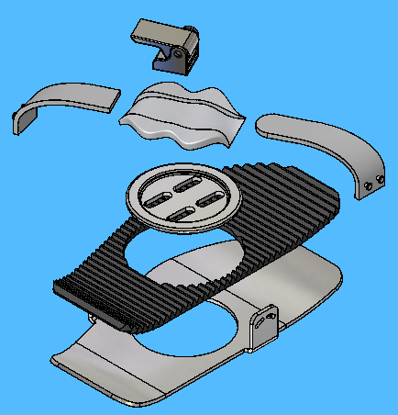
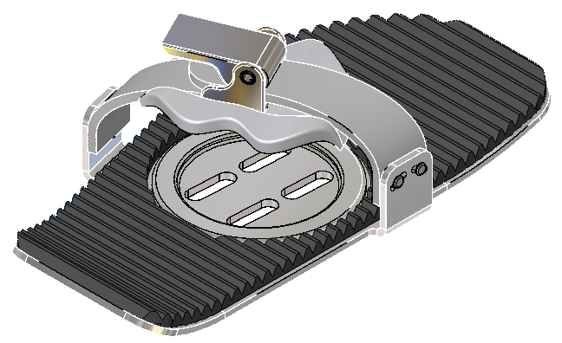
Binding Straps and Pad

Slide 27
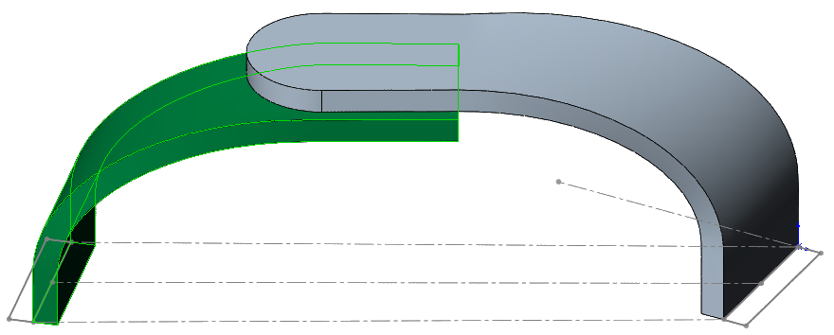
Binding Straps
Straps created in a single part
Solid bodies saved to separate part files
Created as sweeps with guide curves
Guide curves used to:
  Control the sweep profile size and shape
  Control the twist of the profile as it sweeps along the path

Slide 28
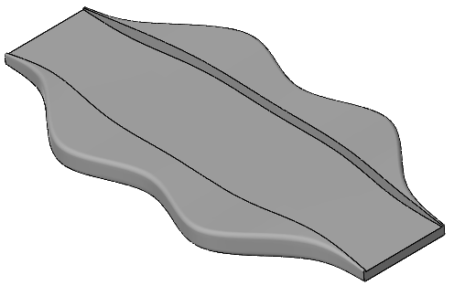
Foam Pad
Created as a loft
Created in the same part as the two straps
Saved as separate part
Flat and curved versions

Slide 29
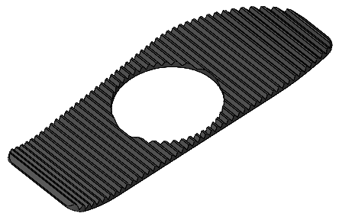
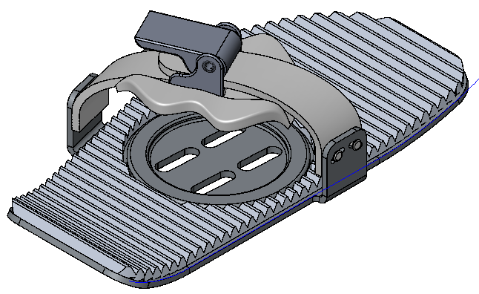
Binding Pad
Created as an In-context feature
Pattern follows curve of Binding Base Plate
Trimmed to shape of Binding Base Plate

